Slide 1
www.MINEPORTAL.in
ONLINE TEST SERIES FOR
GATE MINING
COAL/METAL FIRST/SECOND CLASS
COAL INDIA MT MINING EXAM
OVERMAN/SIRDAR EXAM
OTHER PSU MANAGEMENT TRAINEE EXAM
FREE STUDY MATERIAL/VIDEO LECTURES
ONLINE ORDER MINING BOOKS
CALL/WHATSAPP-8804777500 www.fb.com/mineportal.in

Slide 2
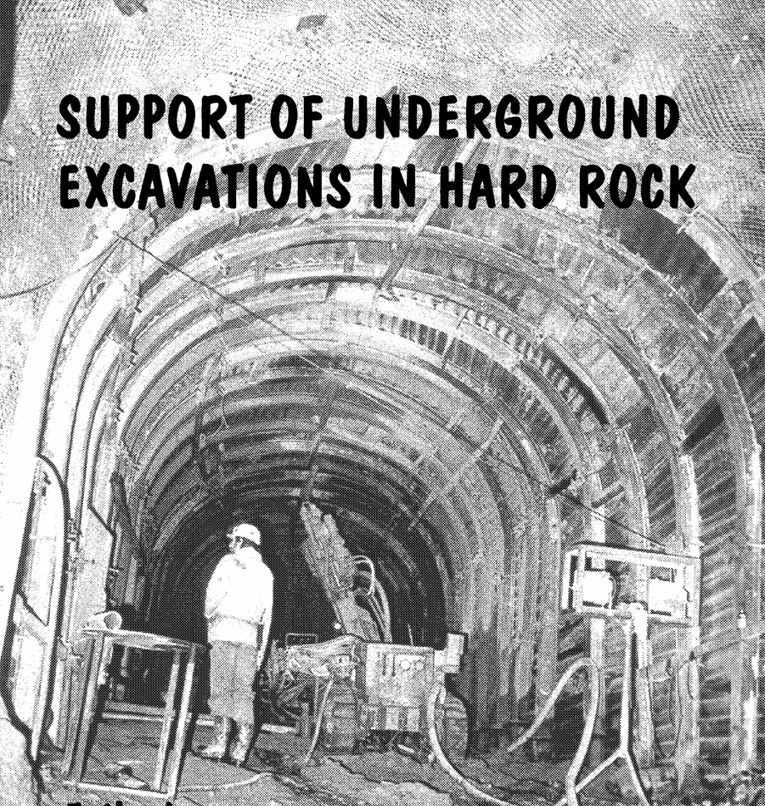

Slide 3
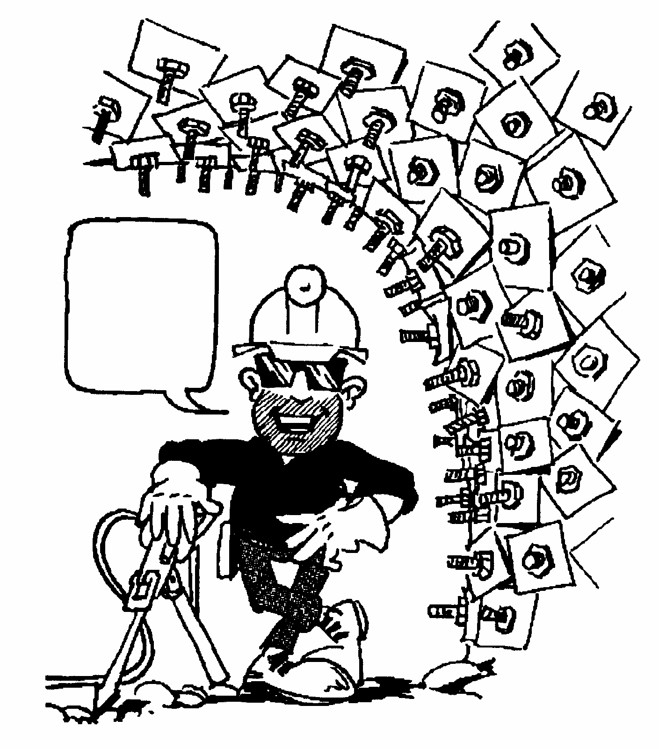
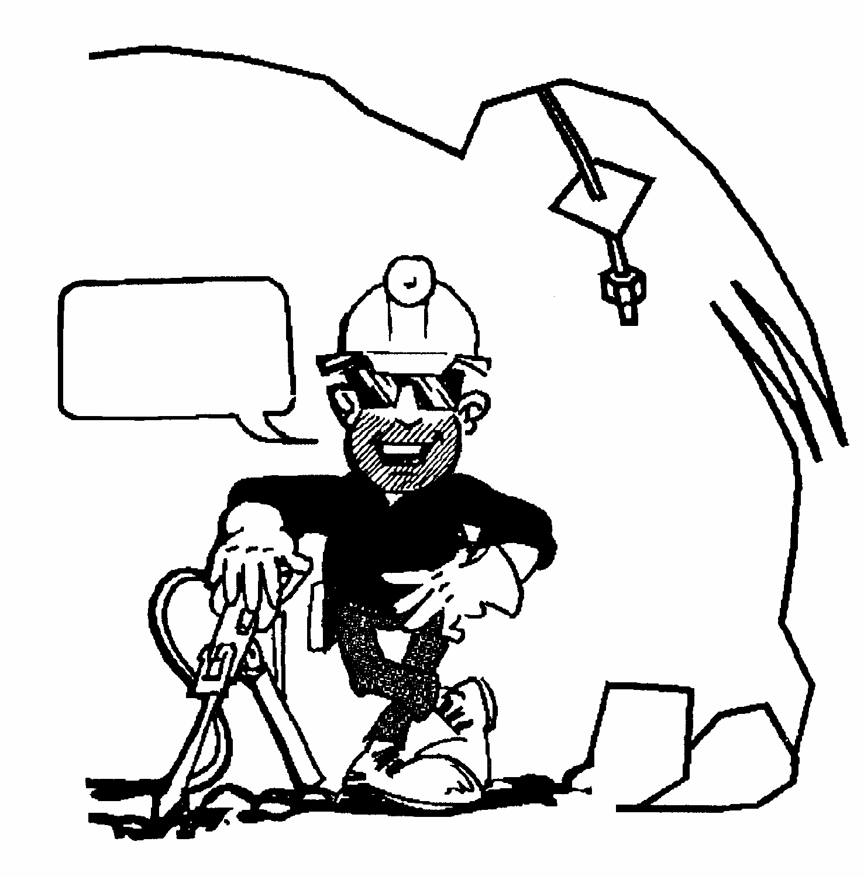
Accessing acceptable risks in design
I don’t believe in taking chances
Who needs rockbolts?

Slide 4
Typical Support Applications
'Typical' mining methods have to be modified to fit the peculiarities of each orebody
A support is not called upon to carry very heavy loads due to large wedge failures or to massive stress induced instability, but its function is to provide an acceptable level of safety for personnel and equipment in the mine
Shafts, shaft stations, underground crusher chambers, underground garages and lunch rooms are ‘permanent’ mining excavations.
Because of the frequent use of such excavations by mine personnel and because of the high capital cost of the equipment housed in these excavations, a significantly higher degree of security is required

Slide 5
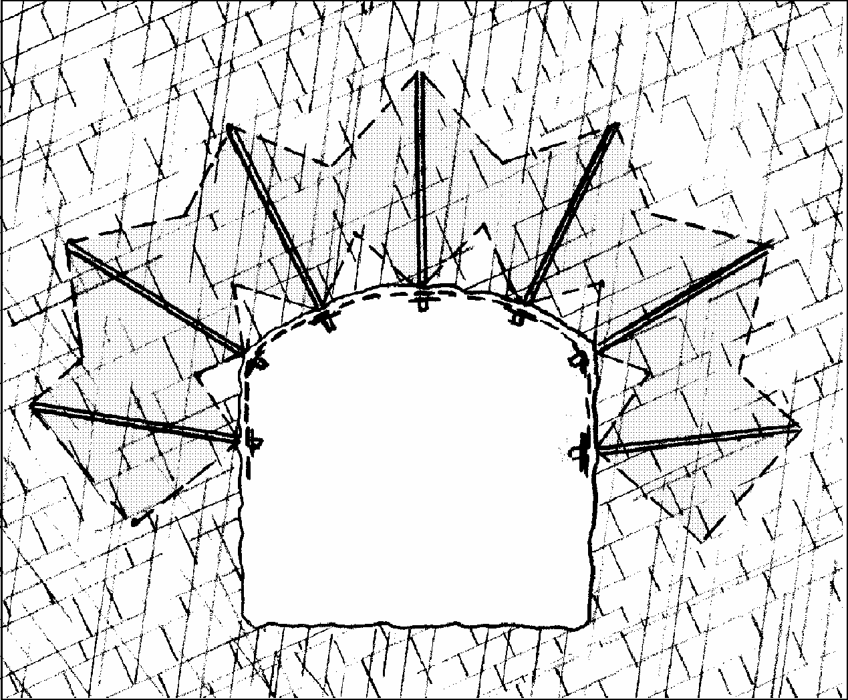
Heavily Jointed Rock
Pattern bolting for the support of heavily jointed rock which can fail by ravelling or squeezing.
The shading represents a zone of compressive stress in which interlocking of individual rock pieces is retained and a self-supporting arch is created.
Mesh or shotcrete should be applied to the excavation surface to retain small blocks and wedges in the stress-free zones between the rockbolts.
The program PHASES has been designed for the evaluation of support options in heavily jointed rock masses

Slide 6
ROOF-BOLTING TECHNOLOGY
Typical bolting techniques used include reinforcing elements such as anchors, bolts, glass fibre bolts, and tendons, with the bonding medium being cement grout or resin, or friction mechanical bolts.
The installation procedure may include pre-and-post tensioning, grouted and un-grouted reinforcement, coupled and uncoupled reinforcement etc.
The rationale behind these reinforcement regimes is:
Rock Support
Strata Reinforcement
Rock Anchoring
Spot Bolting

Slide 7
Roof Bolting (cont…)
The technique can be used over a wide range of rock conditions, including hard rock conditions in shallow mines (where the rock is strong and stresses are low) and deep mines with relatively weak rock and usually fractured.
To realize these results:
Drilling and installing roof-bolts at 90º to the hanging-wall or strata
Achieving full column fill with the grouting medium used
Correct combination of hole diameter, capsule diameter and steel diameter
Correct spin time for resin

Slide 8
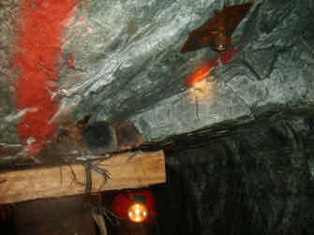
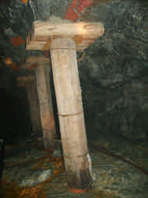
A combination of roof bolts and pre-stressed mine poles installed as face support at a deep level gold mine

Slide 9
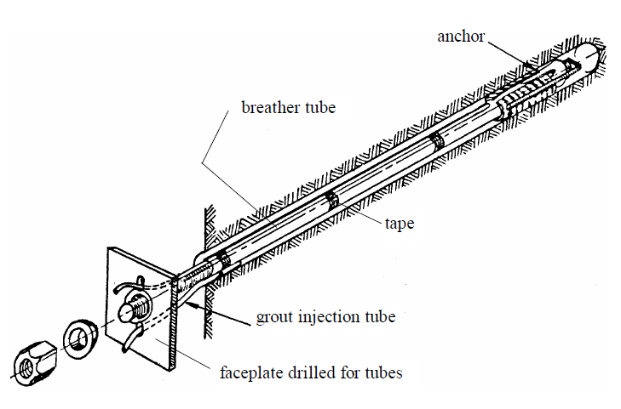
Mechanically anchored Rockbolts
Grout injection arrangements for a mechanically anchored rockbolt

Slide 10
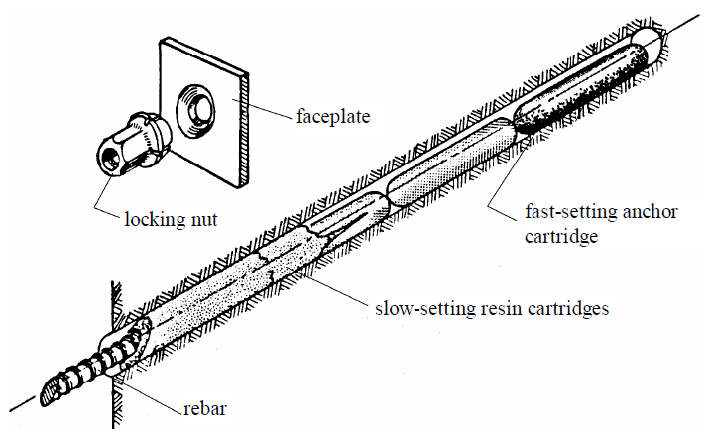
Resin Anchored Rockbolt

Slide 11
Roof-bolting with polyester resin capsules is mostly used at the various coal as well as platinum mines.
This product is supplied as a two-in-one compartment capsule, comprising of polyester resin and a catalyst both covered and separated by a thin plastic membrane.
The separating plastic is broken and destroyed by the spinning of the anchoring element (bolt), with the result that the two products are mixed together to form a very hard and strong bonding compound.
The chemistry of the resin can be altered to give different gel and set times which allows for pre-tensioning by using two different speeds of resin in the same hole
It is important to understand the set time, spin time and the hold time, in order to fully achieve desired results.

Slide 12
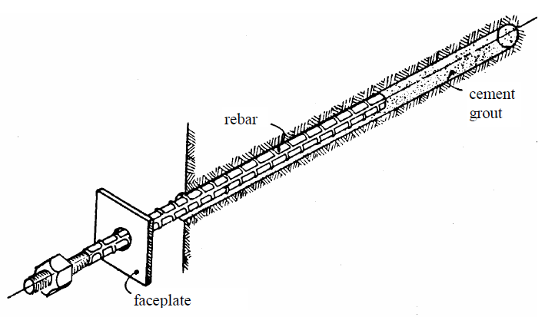
Grouted Dowels

Slide 13
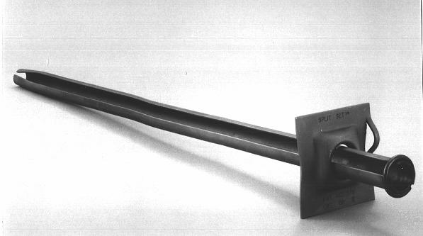
Friction Dowels or Split Set Stabilizers

Slide 14
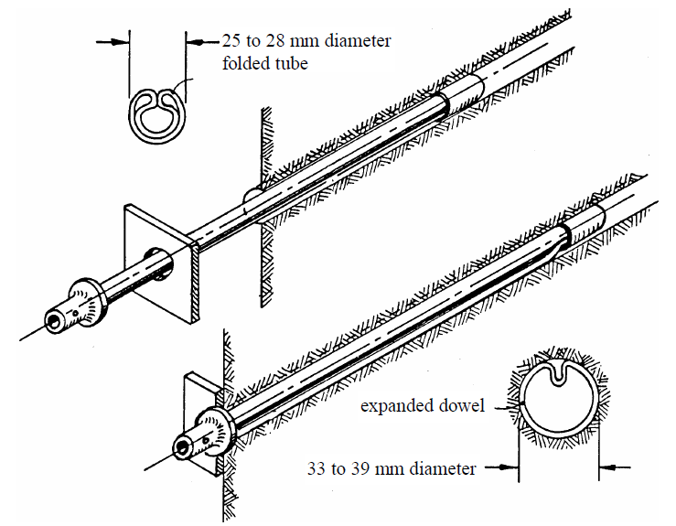
Swellex

Slide 15
Cablebolt

Slide 16
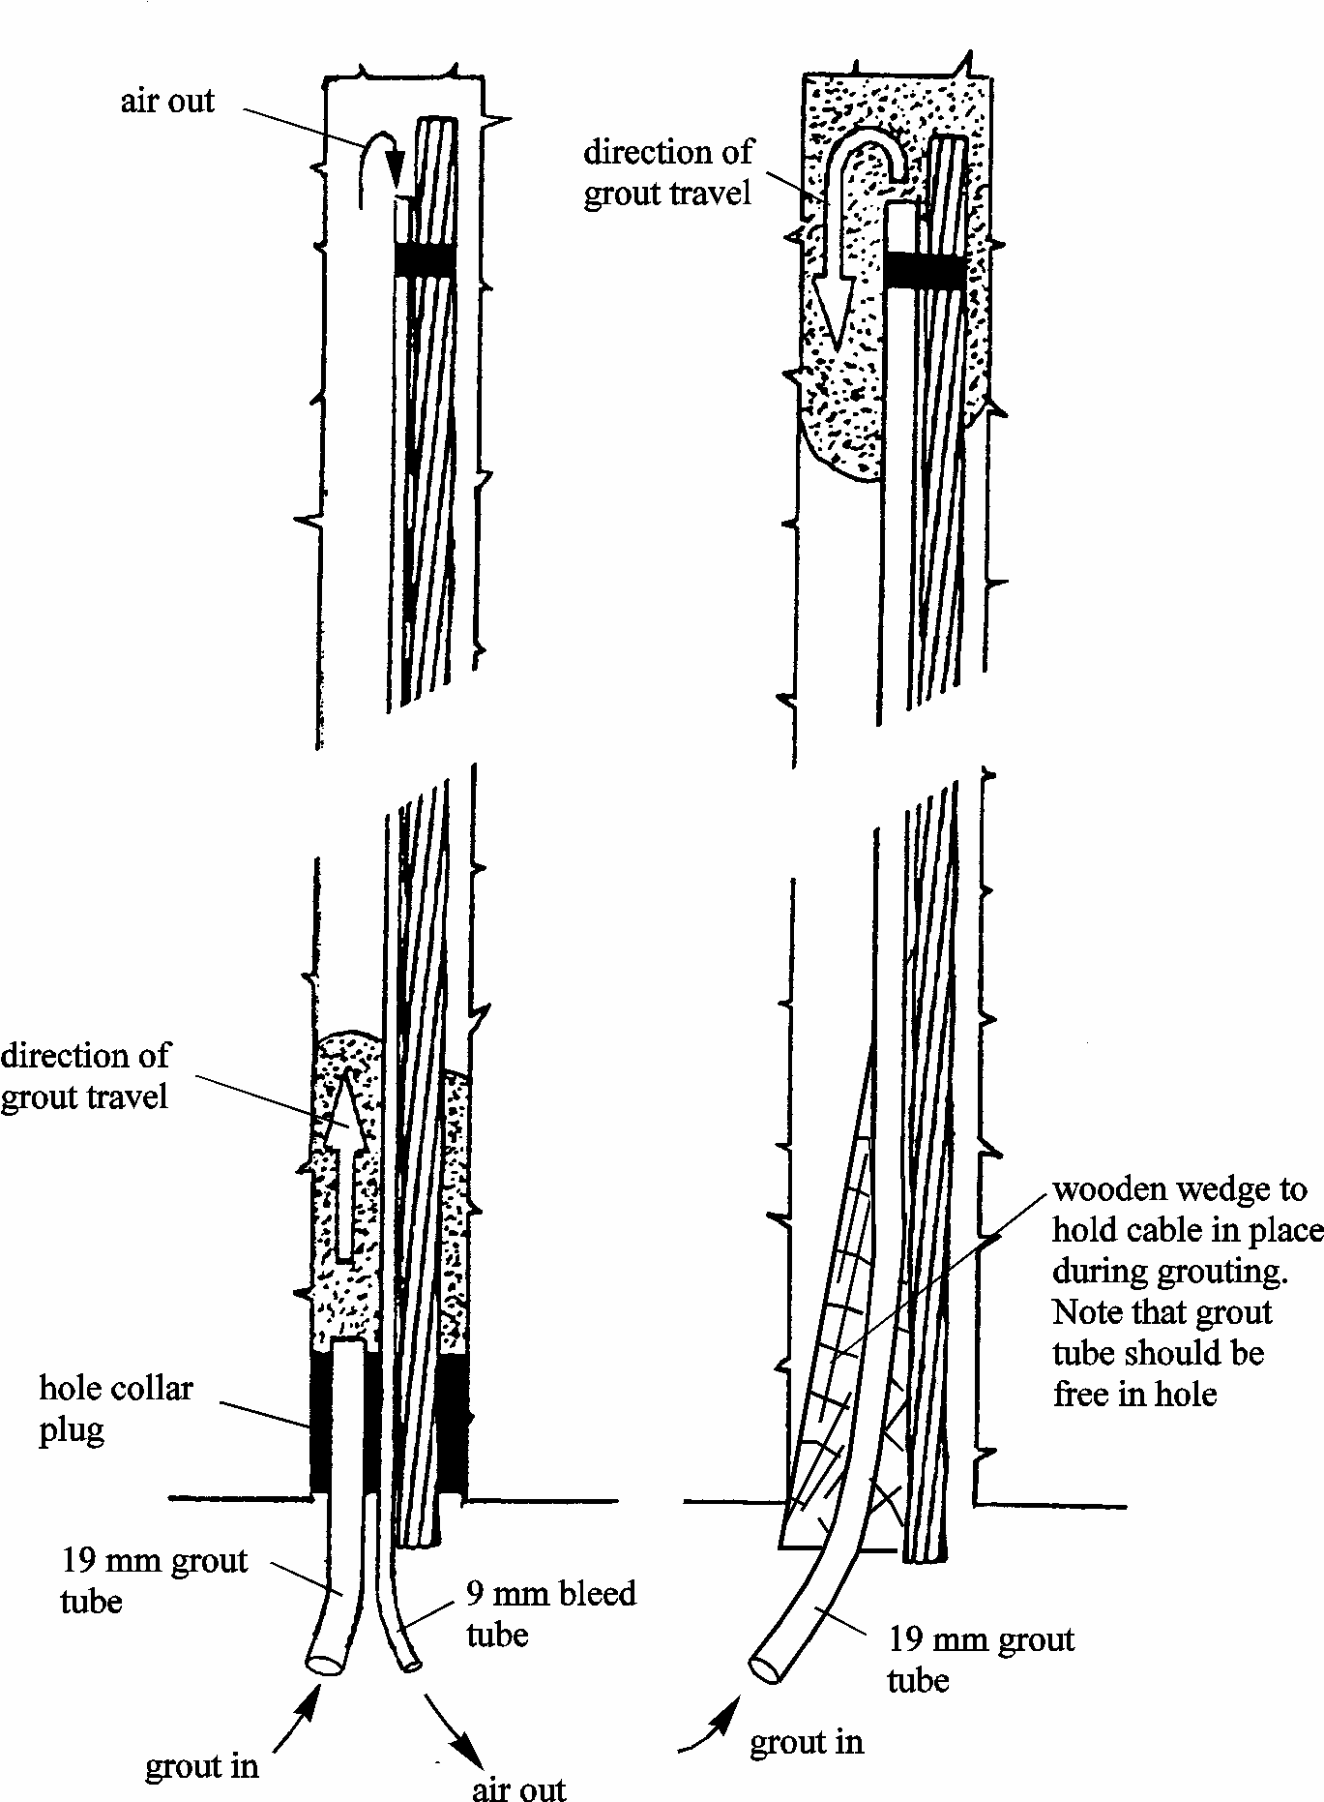
Grout Tube method for grouting cable bolts into upholes

Slide 17
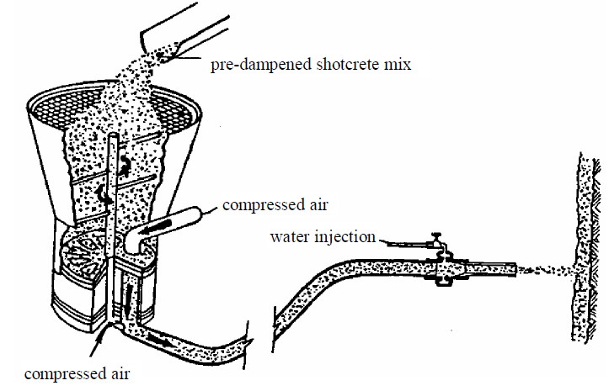
Shotcrete Support
Simplified sketch of a typical dry mix shotcrete system

Slide 18
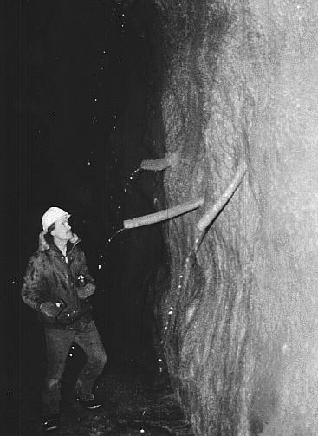
Plastic pipes used to provide drainage for a shotcrete layer
applied to a rock mass with water-bearing joints

Slide 19
THIN SPRAY LINERS (TSL’s)
Provide a protective coating to rock, concrete or coal surfaces which are susceptible to deterioration on exposure to the atmosphere.
Support applications include pillar support, face support, raise bore linings, temporary support in ore passes and for concrete shaft lining repair.
Products used for the TSL application are cement based, solvent free, non-toxic and non-flammable.
They are supplied as a single component powder to which water is added, and the mixed material can be spray or trowel.
TSL’s have the potential to bond and hold key blocks competently together, resulting in a more stable hanging-wall condition, whilst providing excellent aerial coverage at the same time.

Slide 20
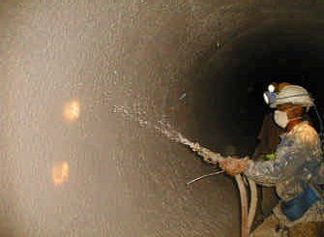
Typical application of TSL for surface protection and support

Slide 21
SAFETY NET
A rectangular net placed as close to the hanging wall of the stope face area as possible, to provide protection during cleaning and drilling operations.
The net is used in conjunction with other stope support systems (props, tendons etc).
It provides extensive aerial coverage (up to 85% of the hanging-wall) and can hold up to 2 tons of rock.
The net is installed and tensioned manually, by attaching the straps to the surrounding stope support system.
Advantages :
Low mass and simple installation and removal procedure
High aerial coverage between support units
Ideal for panes with friable hanging-wall conditions
Net can be re-used

Slide 22
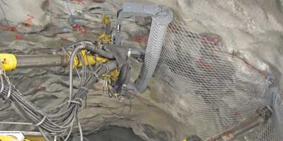
Application of Safety Net in an underground working

Slide 23
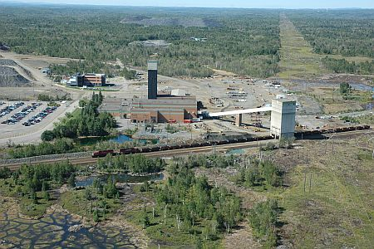
Dynamic Support System at Vale’s Copper Cliff Mine
Geology
The 900 orebody (OB) cross fault, which strikes east-west and dips at about 55° towards north.
The Quartz Diabase Dyke (trap) located between 100 and 900 OBs striking east-west and dipping steeply towards north.
Highly burst prone ground conditions

Slide 24
Rockburst History
40 rockburst/significant seismic event incidents( 35 within 100/900 OBs and 5 in 120 and 880 OBs).
Most significant occurred on 11th Sept 2008, known as 3.8 Mn event.
3000 te material displaced at 5 locations on different levels.

Slide 25
Introduction of burst prone system
Objective
To safeguard and protect the installed support system
To minimize or completely eliminate the damage to the installed ground support and/or the underground excavations in the event of future occurrences.

Slide 26
Energy absorption and load-displacement characteristics of support elements
Description | Peak Load(kN) | Displacement(mm) | Energy Absorption(kJ)
19 mm resin grouted rebar | 120-170 | 10-30 | 1-4
46mm split set bolt(FS-46) | 90-140 | 80-200 | 5-15
16 mm modified cone bolt | 50-100 | 100-200 | 10-25
16 mm cable bolt | 160-240 | 20-40 | 2-6
#4 gauge welded wire mesh | 34-42 | 150-225 | 3-6/m²
Shotcrete and welded wire mesh | 2x mesh | < mesh | 3-5x mesh

Slide 27
Performance
Date | Magnitude(Nuttli) | Orebody | Level (stope) | Remarks
18 Feb 2009 | 2.9 | 100 | 3710–3880 (9551) | No damage to the mine openings
30 Sept2010 | 1.9 | 900 | 3710–3880 (9281)
2 Oct 2010 | 1.6 | 900 | 3710–3880 (9281) | No damage to the mine openings
4 Oct 2010 | 1.4 | 900 | 3710–3880 (9281) | No damage to the mine openings
4 Oct 2010 | 1.2 | 900 | 3710–3880 (9281) | No damage to the mine openings
5 Oct 2010 | 1.9 | 900 | 3710–3880 (9281) | Some minor surface cracks in the shotcrete
15 Oct2010 | 2.3 | 900 | 3710–3880 (9281) | Minor damage to the installed ground support system and some floor heaving

